Slide 1
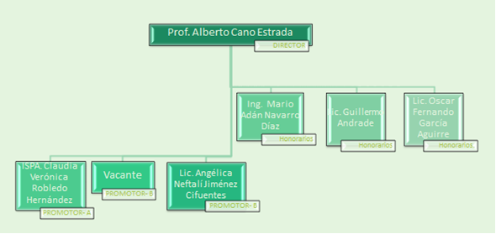
ORGANIGRAMA

